Slide 1

SCREENTIME AND HEALTH FACTOR ANALYSIS
Name = Tanya Singh Roll no. = 2312res698

Slide 2

📖 Dataset Description
This dataset captures students’ screen time behavior and its impact on health and lifestyle. It includes details such as:
Demographics: Age, Gender, Urban/Rural location
Device Usage: Primary device used (Smartphone, Laptop, TV, Tablet)
Screen Time: Average daily usage (in hours)
Usage Purpose: Ratio of educational vs recreational use
Health Impacts: Issues like poor sleep, eye strain, anxiety, etc.
Compliance: Whether students exceeded recommended screen time limits

Slide 3
💡 Key Insights
Screen Time Levels
Average daily screen time ≈ 4.3 hours/day
85% of students exceed the recommended screen time limit.
Device Preferences
Smartphones are the most used device (≈47%), followed by laptops and TVs.
Laptop users spend the most hours on screen daily.
Demographics & Screen Time
Screen time increases with age, especially in older students.
No major difference in screen time between male vs female or urban vs rural students.
Health Impacts
Around 67% reported at least one health issue due to screen time.
Poor sleep and eye strain are the most common problems.
Educational vs Recreational Use
Older students spend proportionally more time on recreational activities than educational ones.
Negative correlation between age and educational/recreational ratio (-0.49).

Slide 4
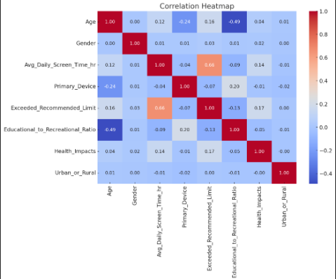
It shows how features (Age, Screen Time, Device, Gender, Health Impacts, etc.) relate to each other and to the target Exceeded_Recommended_Limit.

Slide 5
🤖 ML Prediction (Exceeded Screen Time Limit)
A Random Forest Classifier was trained to predict whether a student exceeds the recommended screen time.
Input Features: Age, Gender, Device, Urban/Rural, Screen Time, Educational/Recreational Ratio, Health Impacts.
Model Accuracy: High accuracy in classifying students who are at risk of exceeding screen time.
Feature Importance:
Avg Daily Screen Time was the strongest predictor.
Health Impacts and Primary Device also played key roles.
This predictive model can help in early identification of at-risk students, enabling targeted interventions.

Slide 6
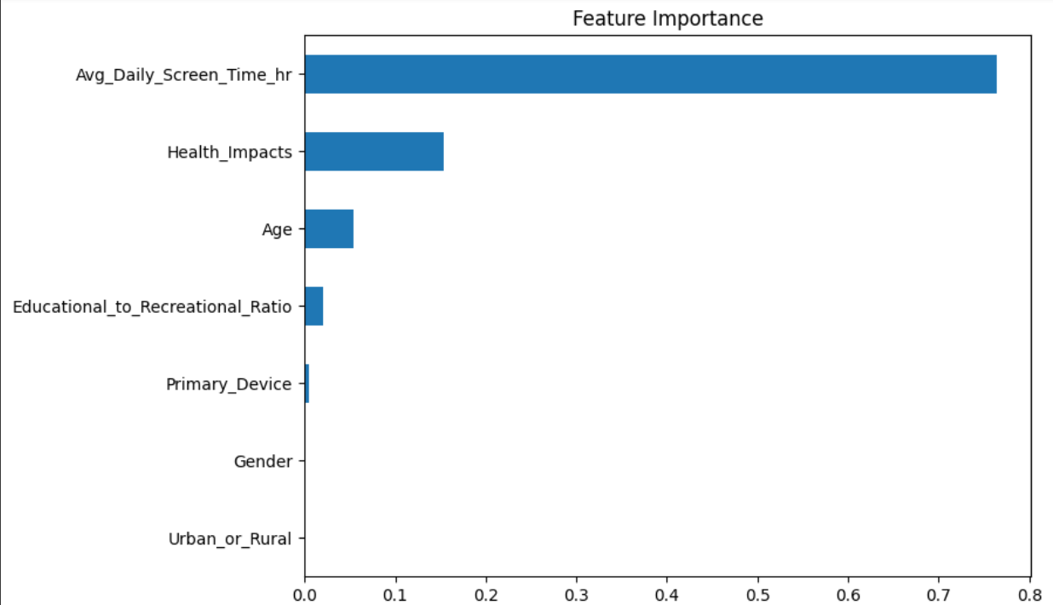

Slide 7
✅ Conclusion
📱 High Screen Time: Majority of students (85%) exceed the recommended daily limit.
🩺 Health Concerns: Over two-thirds face issues like poor sleep, eye strain, and anxiety.
🎓 Educational vs Recreational Use: Recreational use dominates, especially as students grow older.
🌍 Consistent Across Groups: Screen time patterns are similar across gender and location.
🤖 ML Insights: Predictive modeling highlights screen time, device choice, and health impacts as key indicators of exceeding limits.
👉 Takeaway: There is a strong need for awareness, balanced digital habits, and preventive measures to reduce negative health outcomes among students.

